Slide 1
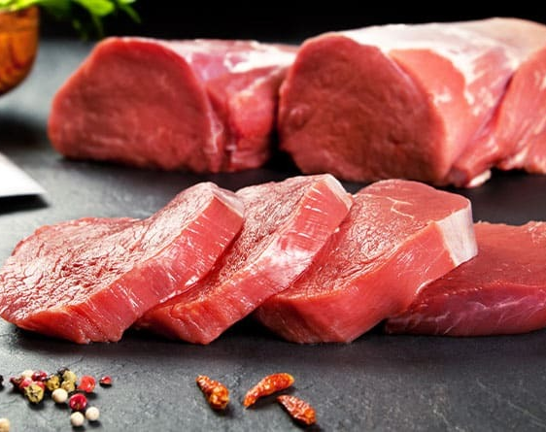
MEAT KING
PRESENTED BY
Rabeya Bosri (2230150)
Afsana Islam (2222077)
Kazi Toushia Nahar (2221696)
Ananna Roy (2220954)
Satirtha Mohanta Dibyo (2120267)
Ashikur Rahman (2021785)

Slide 2

About MEAT KING
Meat King is a specialized online platform designed to meet the rising demand for fresh and high-quality meat products. The project focuses on connecting consumers directly with trusted wholesalers and suppliers, ensuring transparency, reliability, and efficiency in the meat supply chain.
Through Meat King, customers can browse, order, and review a wide range of meat-based products such as beef, chicken, mutton, and duck. The system includes user registration, product listings with images and descriptions, a secure ordering process, and review/rating features for consumer feedback.

Slide 3
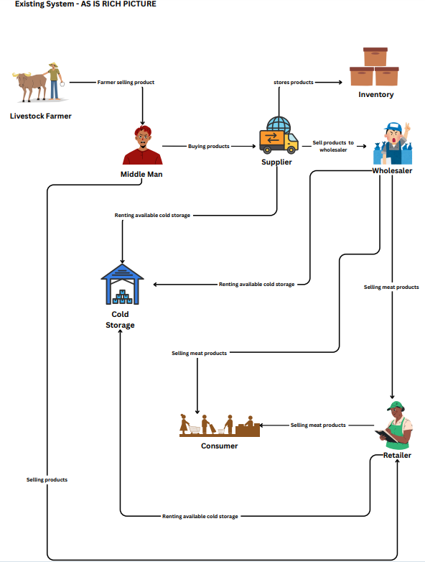
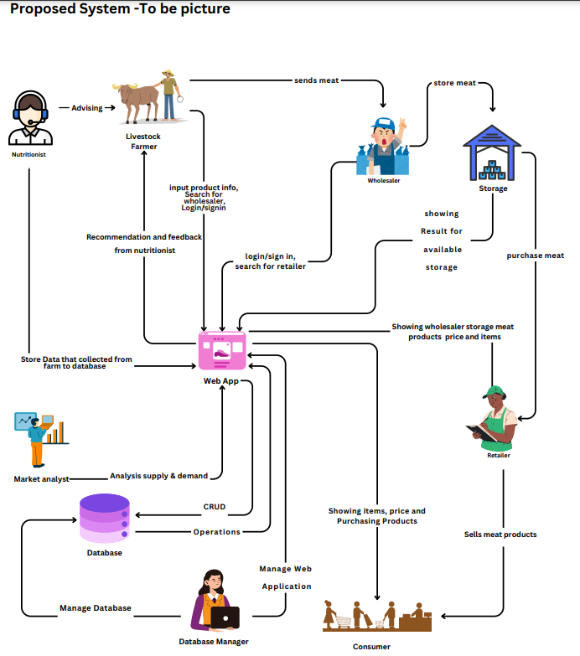
Rich Picture AS-IS VS TO-BE
AS-IS
TO-BE

Slide 4
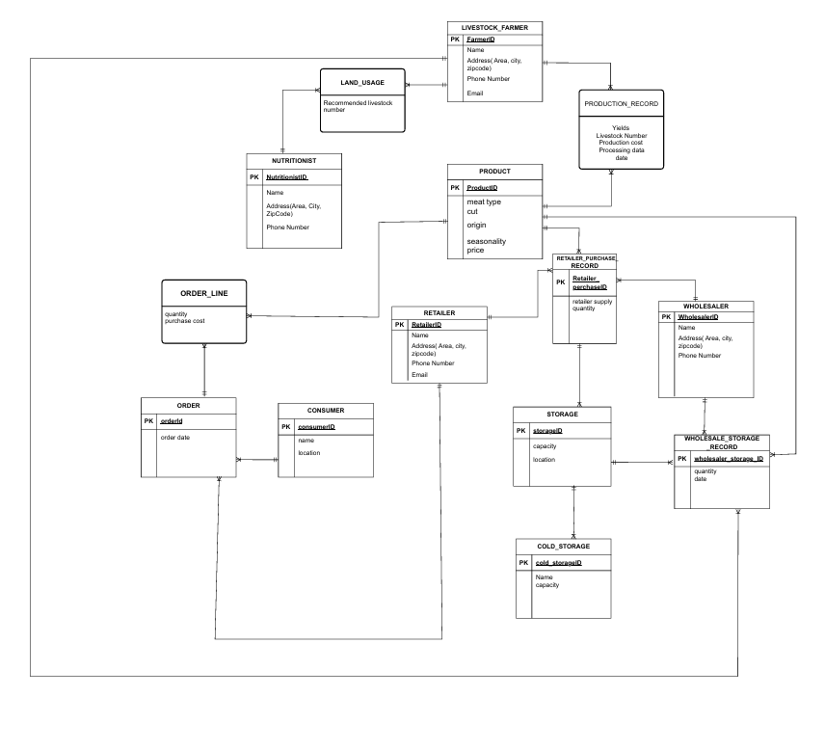
Entity Diagram Relation

Slide 5
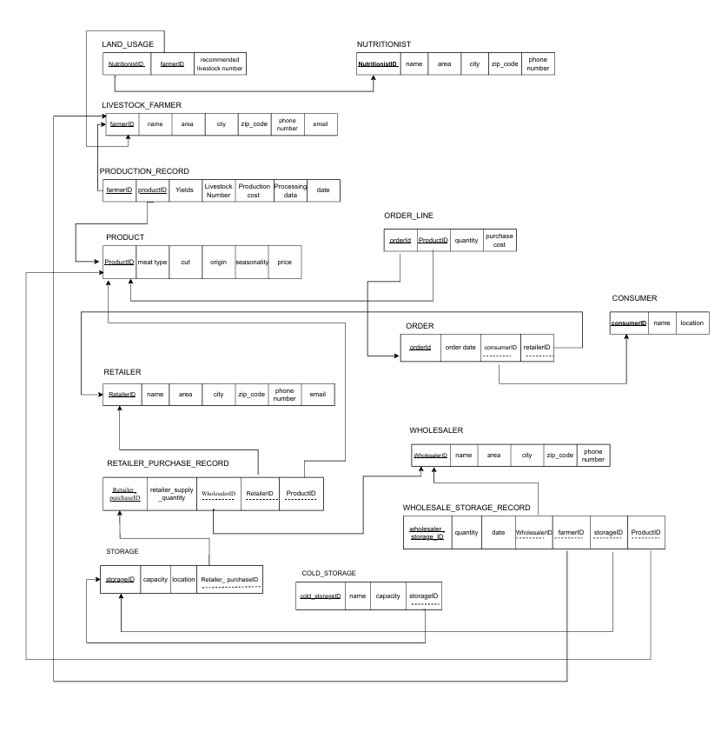
Relational Schema

Slide 6
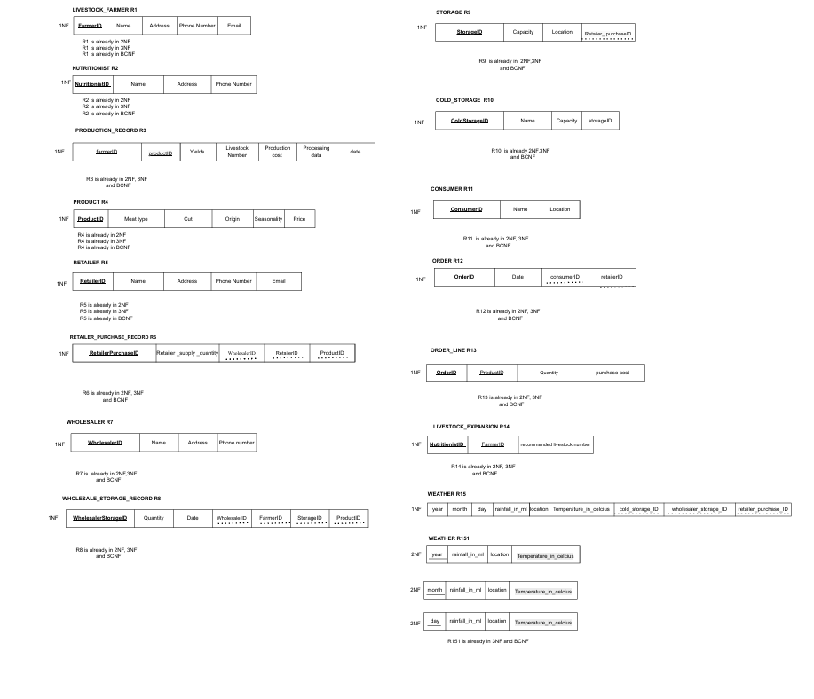
Normalization

Slide 7
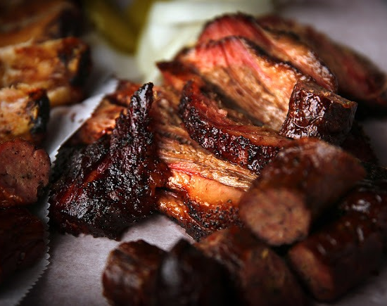
PROBLEM
Challenge faced of designing the final ERD
BACKEND integration
Integration of analytical tools.

Slide 8
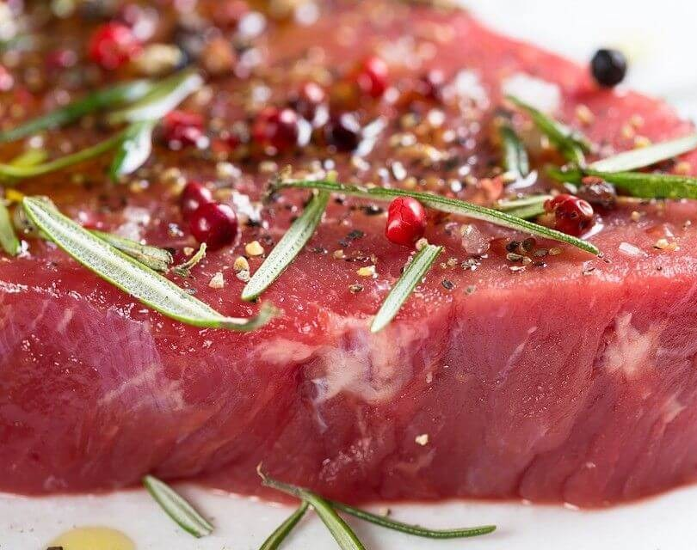
Solution
Normalize up to 3rd Normal Form (3NF) to avoid redundancy and data anomalies.
Use clear naming conventions and identify primary/foreign keys early.
Validate ERD with sample use cases
Normalize up to 3rd Normal Form (3NF) to avoid redundancy and data anomalies.
Use clear naming conventions and identify primary/foreign keys early.
Validate ERD with sample use cases
Normalize up to 3rd Normal Form (3NF) to avoid redundancy and data anomalies.
Use clear naming conventions and identify primary/foreign keys early.
Validate ERD with sample use cases
Normalize up to 3rd Normal Form (3NF) to avoid redundancy and data anomalies.
Use clear naming conventions and identify primary/foreign keys early.
Validate ERD with sample use cases
Handling multiple relationships
Managing many-to-many relations like products in multiple orders.
Including review and rating logic without redundancy.
Normalize up to 3NF

Slide 9
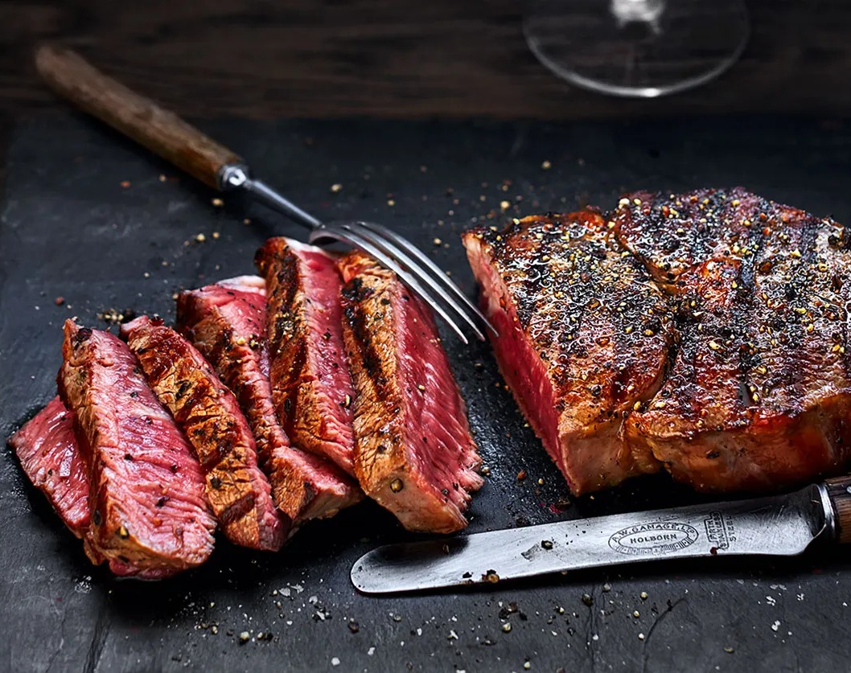
THANK YOU

